Slide 1
Which is more dangerous:
A cutback at the top of the box vs. a drive along the flank?

Slide 2
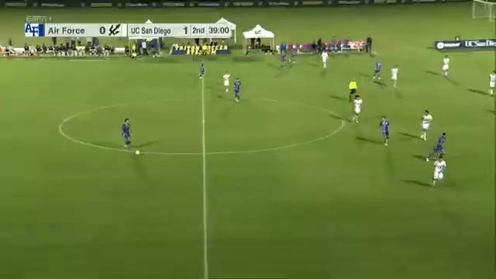

Slide 3
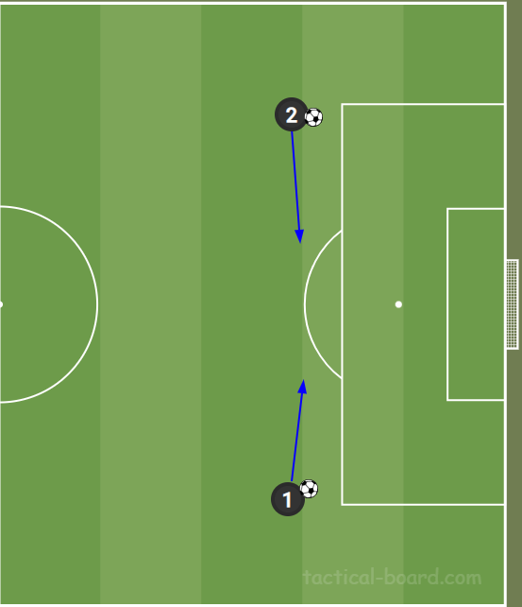
Cutback
Cutback to a shot inside zone 14
Avg xG: .244

Slide 4
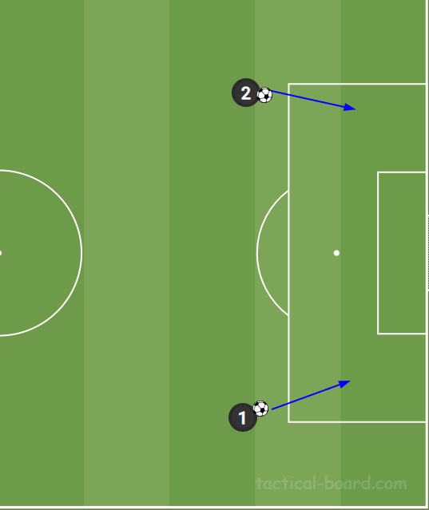
Drive Across Flank
Driving across flank to cross or shot from outside the middle.
Avg xG: .167

Slide 5
46.1%
The percent difference in xG in a cutback vs. a drive across the flank

